Slide 1
Sharing Belonging and Growth Strategies to
Encourage Student Academic Confidence and Success
Donna Nalley, PhD
English Program Director
South University Online
Jennifer Ferraro, MFA
Assistant Program Director
South University Online

Slide 2
Reaching, Retaining, and Supporting Students
*Strategic revision of assignments in our
first-year, developmental writing course
*Instructor-led outreach strategies geared toward underprepared students
*Opportunities for faculty training and development

Slide 3
Activity #1: Your Future Story

Slide 4
“Who Gets to Graduate?”
http://www.nytimes.com/2014/05/18/magazine/who-gets-to-graduate.html?hp&_r=2

Slide 5
ENG 0099: Principles of Composition
ENG 0099 is a welcoming place with student-friendly lectures, assignments, and discussion areas.

Slide 6
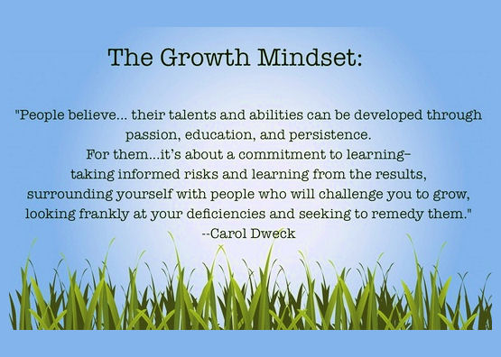

Slide 7
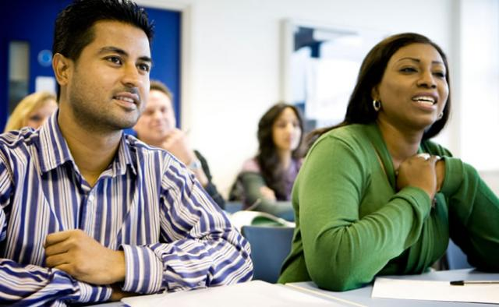
*Students who believe that intellectual ability can be developed through effort are more resilient and successful in college.
*Students who believe they belong in college have a better chance of succeeding. A student’s mindset and emotional resources are key factors in their success and persistence.

Slide 8
Many of our students are non-traditional, first-generation, first-year students who are required to take a developmental, pre-college writing course.
Many are parents and work full-time at one or more jobs. Most have not been in school for many years and come from socioeconomically underprivileged backgrounds.

Slide 9
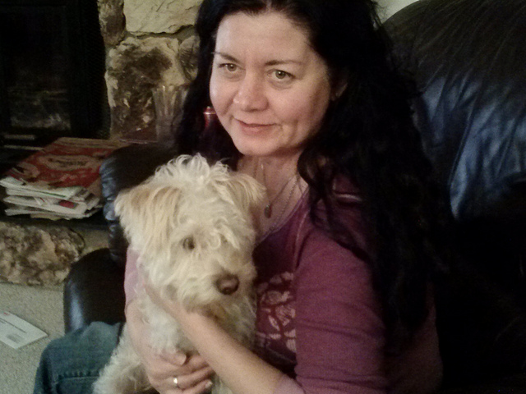
April is a busy 40-year-old mother of four. She has been trying to finish her degree for the past 10 years while raising children and supporting her husband’s career. She struggles with lack of confidence in her academic abilities and time management, and she fears being recognized as an “older” student by her more traditionally aged classmates.

Slide 10
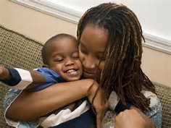
Talitha is a 21-year-old single mother who dropped out of high school after having her first child at age 17. She currently works in the fast-food industry and barely makes enough for basic survival. Having completed her GED, she desperately wants to improve her economic future for her children by getting a degree in Allied Health Sciences. She is the first person in her family to attend college.

Slide 11
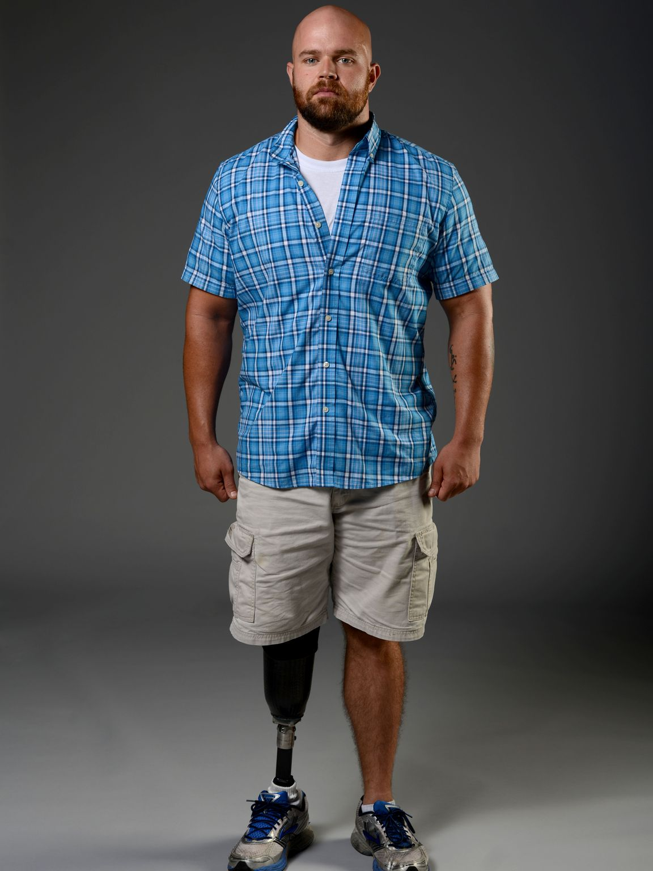
John is retired from his career in the Army,
where he completed
two tours of Iraq. He was medically discharged as physically and emotionally disabled. John is now completing an online degree in Information Technology so he can start a new career that
is manageable with
his disabilities.

Slide 12
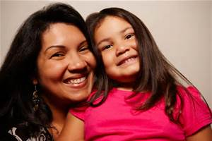
Maria is a first-generation American and mother of five children. Since her divorce, she has worked as a Certified Nursing Assistant in nursing homes. She hopes to become a nurse in order to advance and make a higher income. She also wants to become a model for her children that they too can go to college and be successful. She is the first in her family to graduate high school and to attend college.

Slide 13
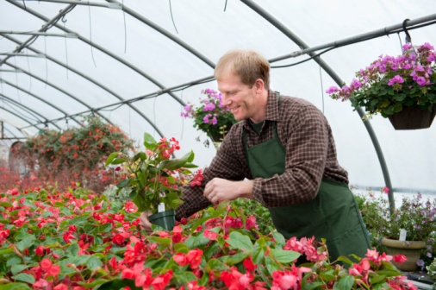
Time Out for Quick Questions or Comments

Slide 14
Reaching Students through Targeted Assignments
We often hear negative messages in ENG 0099. Students will comment, “I’m just not smart enough” or “I’m not a good writer.”

Slide 15
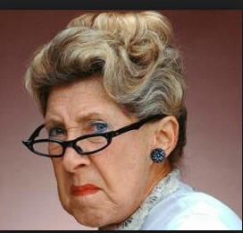
Overcoming Negative Messages from Authority

Slide 16
Encouraging Themselves through Helping Others

Slide 17
Activity #2: An Educational Experience

Slide 18
Final Self-Evaluation in the Journal

Slide 19
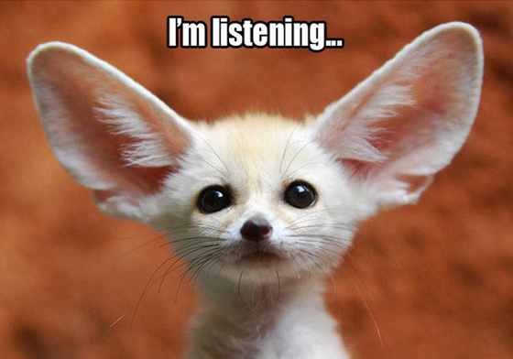
Retaining Students through Quality Feedback

Slide 20
Retaining Students through Quality Feedback
Understandable
Selective
Specific
Timely and Forward Looking
Non-Judgmental
Transferable
personal

Slide 21
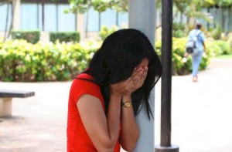
Responding to a First Plagiarism Incident
First-generation college students often over-estimate the impact of discouraging events, such as an initial plagiarism incident.

Slide 22
Retaining Students through Active Outreach

Slide 23
Outreach and Feedback in the Journal and Gradebook

Slide 24
Supporting Students through
Training and Developing Faculty

Slide 25
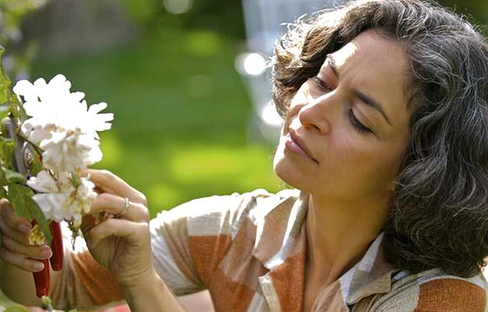
Time Out for Quick Questions or Comments

Slide 26
Activity #3: Creating Growth and Belonging in an Assignment or Course

Slide 27
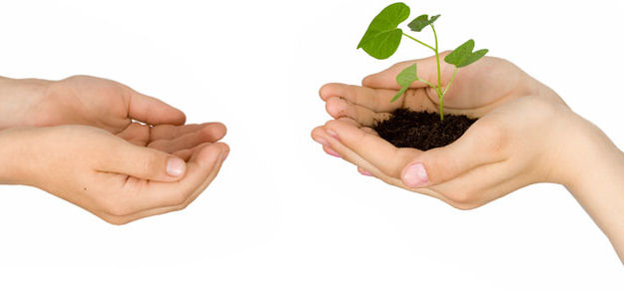
Time for Sharing
Share your revised assignment or dream course with another person in the group.
Explain the course/assignment, students, tasks, resources, approach, and expectations for outreach, feedback, and faculty training and development.
Do we have any volunteers to share a revised assignment or dream course with the whole group?

Slide 28
Links for Further Reading
http://chronicle.com/article/Carol-Dwecks-Attitude/65405/
https://teachingcommons.stanford.edu/teaching-talk/%E2%80%9Cgrowth-mindset%E2%80%9D-interventions
https://teachingcommons.stanford.edu/teaching-talk/belonging-matters
http://www.ascd.org/publications/educational-leadership/sept10/vol68/num01/Even-Geniuses-Work-Hard.aspx
http://larryferlazzo.edublogs.org/2013/01/17/heres-the-growth-mindset-article-prompt-were-using-as-part-of-our-semester-final/
http://www.chaffey.edu/titlev/strategies.html
http://www.perts.net/files/articles/PERTS_Summary_January_2014.pdf
http://www.hightechhigh.org/unboxed/issue10/mindsets_and_student_agency_contributors/

Slide 29
Final Questions, Comments, and
Your Ideas for Implementation

Slide 30
Our Contact Information
Jennifer Ferraro, MFA
Assistant Program Director English, South University Online
jlferraro@southuniversity.edu
505-216-5161
Donna Nalley, PhD
Director of English
South University Online
dnalley@southuniversity.edu
850-508-3380

